Slide 2
Cognitive Services Build smarter, more engaging experiences with knowledge & intelligence services from Microsoft.
B855
John Psaroudakis
Program Manager, Bing
Ryan Galgon
Sr. Program Manager, TnR
Mike Hall
Principal SW Architect, TnR

Slide 3

Cognitive Services
Vision
From faces to feelings, allow your apps to understand images and video
Microsoft Cognitive Services
Give your apps a human side
Speech
Hear and speak to your users by filtering noise, identifying speakers, and understanding intent
Language
Process text and learn how to recognize what users want
Knowledge
Tap into rich knowledge amassed from the web, academia, or your own data
Search
Access billions of web pages, images, videos, and news with the power of Bing APIs

Slide 4
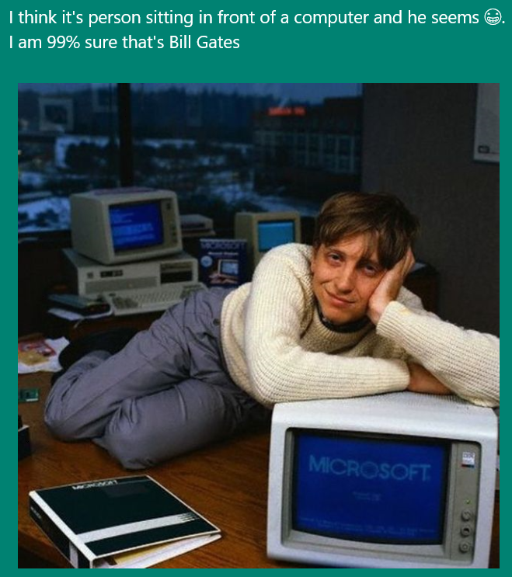
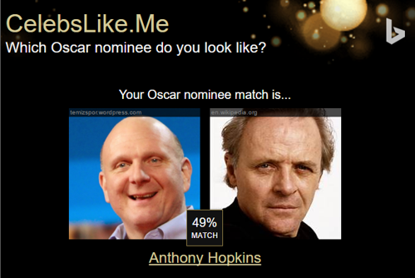

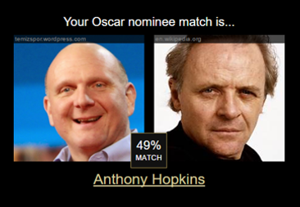
Apps Powered by MS Cognitive Services
I think it’s a person sitting in front of a computer and he seems ☺. I am 99% sure that’s Bill Gates
CaptionBot.ai
Celebslike.me
ProjectMurphy.net

Slide 5







Why Microsoft Cognitive Services ?
Easy
Flexible
Tested
Roll your own with REST APIs
Simple to add: just a few lines of code required
Make the same API code call on iOS, Android, and Windows
Integrate into the language and platform of your choice
Built by experts in their field from Microsoft Research, Bing, and Azure Machine Learning
Quality documentation, sample code, and community support
GET A KEY
BUILD

Slide 6

Cognitive Services
microsoft.com/cognitive
Vision
Speech
Language
Knowledge
Search
Computer Vision
Custom Recognition
Bing Spell Check
Academic Knowledge
Bing
Web Search
Emotion
Speaker Recognition
Linguistic Analysis
Entity Linking
Bing
Image Search
Face
Speech
Language Understanding
Knowledge Exploration
Bing
Video Search
Video
Translator
Text Analytics
Recommendations
Bing
News Search
WebLM
Bing
Autosuggest

Slide 7
Cognitive Services
microsoft.com/cognitive
Vision
Speech
Language
Knowledge
Search
Computer Vision
Custom Recognition
Bing Spell Check
Academic Knowledge
Bing
Web Search
Emotion
Speaker Recognition
Linguistic Analysis
Entity Linking
Bing
Image Search
Face
Speech
Language Understanding
Knowledge Exploration
Bing
Video Search
Video
Translator
Text Analytics
Recommendations
Bing
News Search
WebLM
Bing
Autosuggest

Slide 8
Bing

Slide 9













Bing beyond search in bing.com
Smarter, more engaging experiences
Trusted by industry-leading experiences
apple

Slide 10








Introducing Bing Search API v5
Search API v5
Web Search
Enhanced Search and Filtering Capabilities
Image Search
Web-
Scale
Secure (HTTPs)
High Performance
Video Search
News Search
REST
Autosuggest
Ongoing Improvements and Support
Spell Check

Slide 11
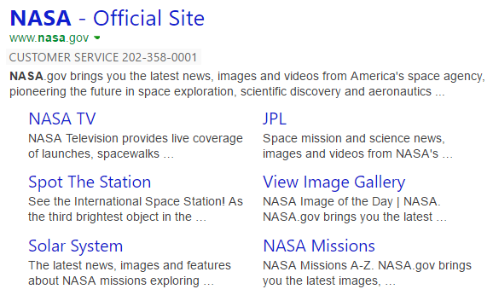

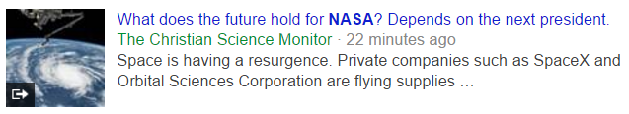
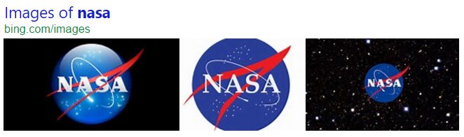
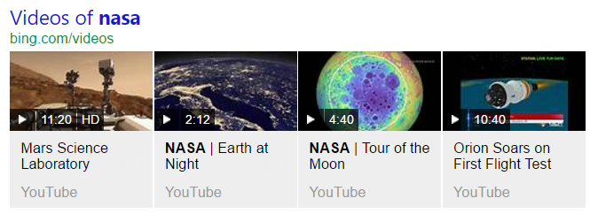
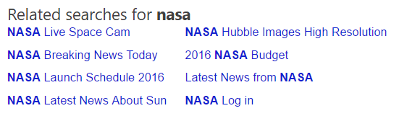
Web Search API
Web Search API
Get relevant web and answer results and metadata with one API call
https://bingapis.azure-api.net/v5/search?q=nasa
Web
Results
Search Response
Deep Links
(1st Algo)
{
“_type”: “SearchResponse”,
“queryContent”: {…},
“webPages”: {…},
“news”: {…},
“images”: {…},
“videos”: {…},
“relatedSearches”: {…},
“rankingResponse”: {…}
}
News Results
Ranking Response
Image
Results
{
“answerType”:”WebPages”,
“resultIndex”:0,…
},
{
“answerType”:”News”,
“resultIndex”:1,…
}
Video Results
Related Searches
*screenshots show actual search results on bing.com

Slide 12
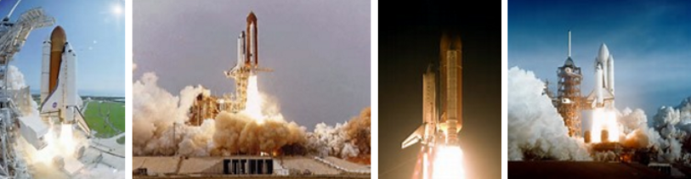
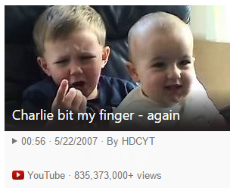

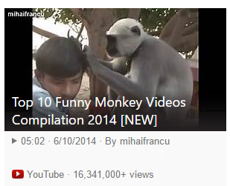
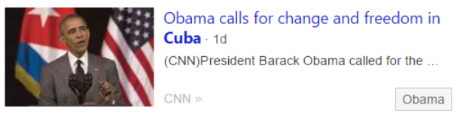
Vertical Search APIs
Get more results, features and metadata tailored to each search vertical
Image Search API
https://bingapis.azure-api.net/v5/images/search?q=shuttle+launch
Enhanced metadata and filters (size, license, style, freshness, color)
Image insights (entity recognition, visually similar)
source: nasa.gov
Video Search API
https://bingapis.azure-api.net/v5/videos/search?q=viral+videos
Enhanced metadata and filters (price, resolution, length, freshness)
Motion thumbnails (video preview)
source: youtube.com
News Search API
https://bingapis.azure-api.net/v5/news/search?q=cuba
News by category/market, and trending news
Rich article metadata (featured entities)
source: cnn.com
*screenshots show actual search results in bing.com

Slide 13
Accessing the APIs
Obtain API subscription key from microsoft.com/cognitive
Call REST endpoint, and pass API key via special header
GET https://bingapis.azure-api.net/v5/search?q=nasa HTTP/1.1
OCP-Apim-Subscription-Key: <API KEY>

Slide 14
Demo
microsoft.com/cognitive
Start coding

Slide 15
LUIS + Computer Vision

Slide 16
Language Understanding Models
{
“entities”: [
{
“entity”: “flight_delays”,
“type”: “Topic”
}
],
“intents”: [
{
“intent”: “FindNews”,
“score”: 0.99853384
},
{
“intent”: “None”,
“score”: 0.07289317
},
{
“intent”: “ReadNews”,
“score”: 0.0167122427
},
{
“intent”: “ShareNews”,
“score”: 1.0919299E-06
}
]
}
“News about flight delays”

Slide 17
Language Understanding Models
Reduce labeling effort with interactive featuring
Seamless integration to Speech API
Deploy using just a few examples with active learning
Supports 5 languages (English, Chinese, Italian, French, Spanish)
Define
Concepts
Provide
Examples
Deploy
Active Learning

Slide 18
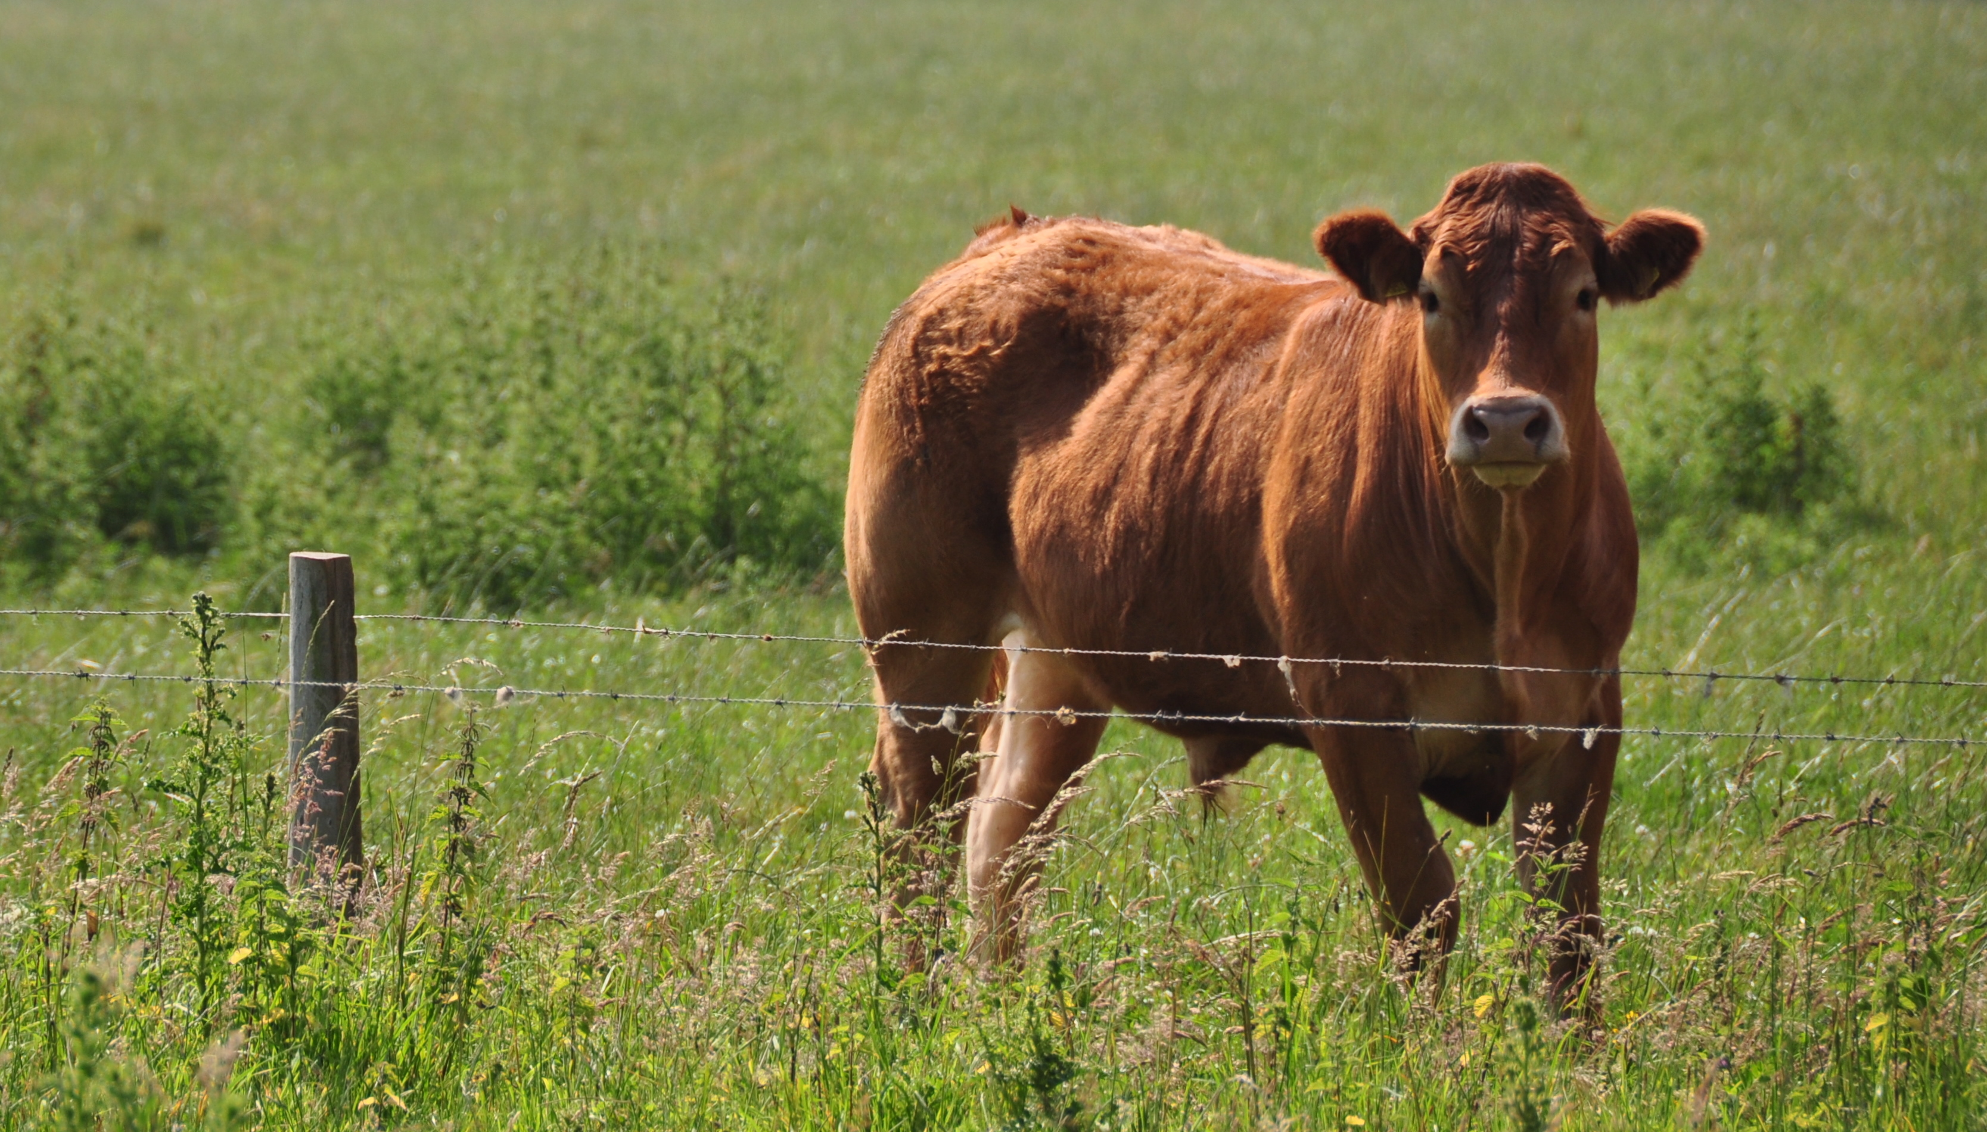
Updated Computer Vision API
Content of Image:
Categories v0: [{ “name”: “animal”, “score”: 0.9765625 }]
V1: [{ "name": "grass", "confidence": 0.9999992847442627 },
{ "name": "outdoor", "confidence": 0.9999072551727295 },
{ "name": "cow", "confidence": 0.99954754114151 },
{ "name": "field", "confidence": 0.9976195693016052 },
{ "name": "brown", "confidence": 0.988935649394989 },
{ "name": "animal", "confidence": 0.97904372215271 },
{ "name": "standing", "confidence": 0.9632768630981445 },
{ "name": "mammal", "confidence": 0.9366017580032349, "hint": "animal" },
{ "name": "wire", "confidence": 0.8946959376335144 },
{ "name": "green", "confidence": 0.8844101428985596 },
{ "name": "pasture", "confidence": 0.8332059383392334 },
{ "name": "bovine", "confidence": 0.5618471503257751, "hint": "animal" },
{ "name": "grassy", "confidence": 0.48627158999443054 },
{ "name": "lush", "confidence": 0.1874018907546997 },
{ "name": "staring", "confidence": 0.165890634059906 }]
Describe
0.975 "a brown cow standing on top of a lush green field“
0.974 “a cow standing on top of a lush green field”
0.965 “a large brown cow standing on top of a lush green field”

Slide 19
Demo
microsoft.com/cognitive
Start coding

Slide 20
Translator

Slide 21
Translator API
NEW:
Translate speech
Not NEW - but still very useful:
Translate text between 50 languages, any to any
Highly customizable translation
Collaborative methods for engaging the community to improve translation
Self-service custom training, using your previously translated documents
AJAX, REST and SOAP interface
Methods:
Translate, Detect, Speak, AddTranslation, GetTranslations, BreakSentences
Array variants of the above

Slide 22
Demo
microsoft.com/cognitive
Start coding

Slide 23



Speech Translation Service
Client app
Automatic Speech Translation
Send voice
Receive translated text
Receive translated audio
Optimized for conversations
Human-to-human conversations,
not only simple utterances
Languages supported
Speech languages: 8
Text languages: 50+
Pay-per-second
$12/hour, 2 hours free
Translated text
Translator

Slide 24
New: Translate Speech - Close to real-time
Provided as a WebSocket API
Send: Stream of audio in PCM encoding
Receive: Stream of
Text of the partial recognition
Translated text of the partial recognition
Final recognition *
Final translation
Optional: Audio of the final translation (PCM encoding)
* Final recognition triggered by 500ms silence
Same technology as used in Skype Translator

Slide 25
Example of a speech translation method call
wss://dev.microsofttranslator.com/api/speech?from=en-US&to=de-DE&voice=de-DE-Katja&features=TextToSpeech,Partial&profanity=Strict
http headers:
Accept: application/json; version=4
Authorization: {ADM token}
Translate from English to German
Choose a specific female voice
Return audio
Return partial results (before 500ms silence)
Apply strict profanity filtering

Slide 26
Speech API Application Flow
Setup to receive audio
Get an oAuth token
Connect to Microsoft Translator via a websocket
OnConnect; setup header, and begin sending audio
Receive Messages, parse JSON to get Recognized Text and Translated Text
Receive Audio data in chunks
Play audio and display the text
Disconnect websocket when session is complete

Slide 27
Demo
microsoft.com/cognitive
Start coding

Slide 28
Developer Call to Action
Sign up and get started today for free at www.microsoft.com/cognitive

Slide 29
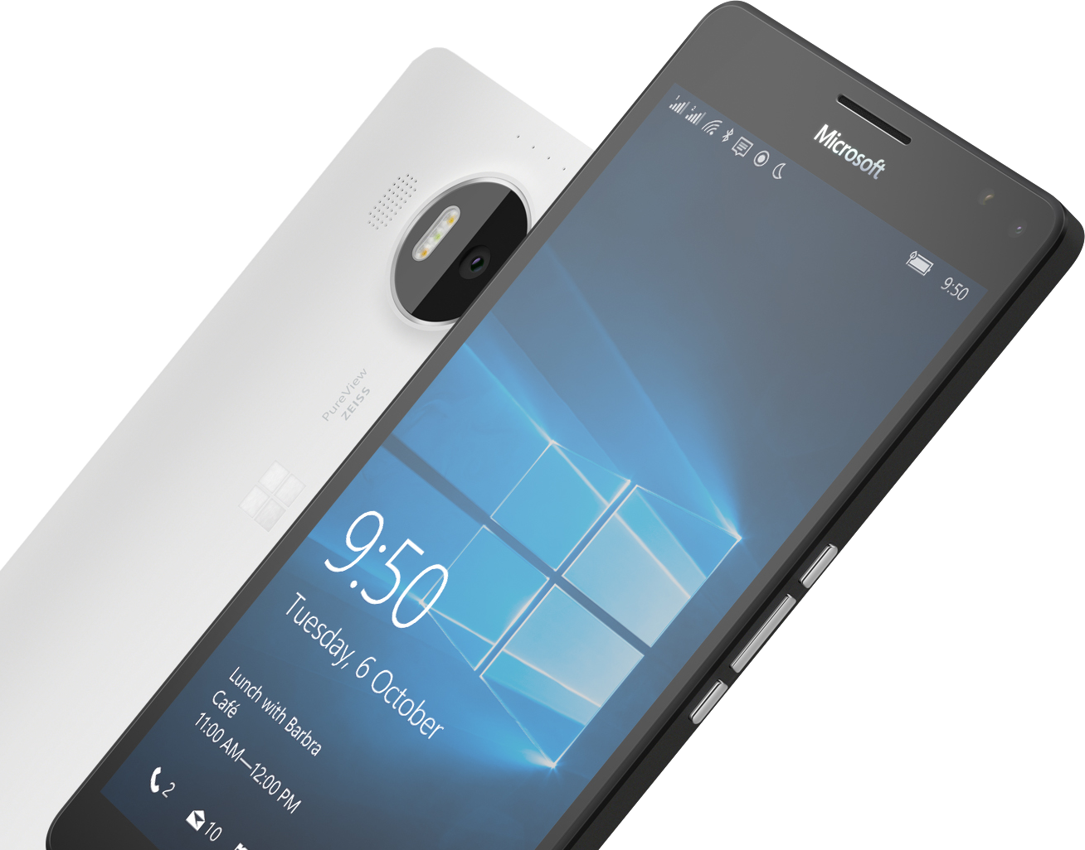
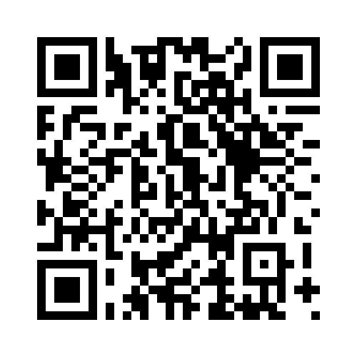

Please Complete An Evaluation Form Your input is important!
or

Slide 30
Questions?

